Slide 1
Making this resource work for you
Prior to teaching this lesson, please refer to the ‘Unit Overview and Planning Document’.
Further guidance on planning Science Mastery lessons can be found in the detailed planning guidance document.
Refer to the ‘notes’ section on each slide for useful information, including suggested expositions, pedagogical content knowledge, suggested questions, answers and more. Consider using presenter mode so you can see this guidance throughout the lesson.
The introduction slides can be adapted to suit your teaching style and the needs of your class.
Before the lesson, adapt the fix-it slide to address any misconceptions identified in the previous lesson’s exit ticket.
Choose from the suggested activities to suit your class. The intention is not that you complete all of these, but that you select those which ones are most appropriate for your students. It may be appropriate to further adapt activities for your students.
These lessons are designed to occupy approximately 1 hour. To adapt for a shorter or longer lesson duration we advise you to adapt the activity section accordingly.
Please consider using the final slide to send feedback about this lesson or examples of PowerPoints that you have adapted to our design team. Your feedback is used to improve Science Mastery for all of our teachers and students. We appreciate all suggestions and comments.
Thank you for reading!
The Science Mastery Team

Slide 2
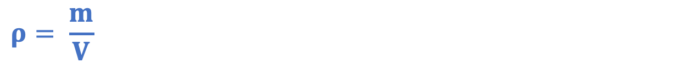
Gas Pressure
Answer the questions below.
Define density.
State the equation used to calculate density.
Describe the movement of particles in a gas.
Define internal energy.
Describe what happens to the movement of particles in a gas as they are heated.
Mass per unit volume
$$ρ= \frac{m}{V}$$
Particles in a gas move randomly in all directions.
The total amount of kinetic and potential energy of all the particles in a system.
They gain kinetic energy so move more quickly.
Notes:
Big idea: Energy is conserved
Foundation: Which state(s) of matter can be compressed?
Stretch: Explain your answer.
Answers:
Foundation: Gases only
Stretch: When something is compressed, the spaces between its particles decrease. There are no spaces between particles in liquids or solids, so they cannot be decreased.

Slide 3
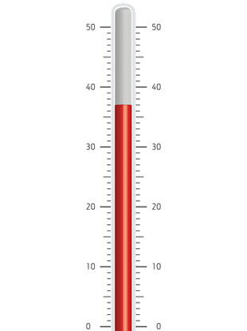
Gas Pressure
Do Now:
Define density.
State the equation used to calculate density.
Describe the movement of particles in a gas.
Define internal energy.
Describe what happens to the movement of particles in a gas as they are heated.
Drill:
State the unit usually used to measure temperature.
State the temperature shown on the thermometer.
State the resolution of this thermometer.
Notes:
Drill answers
ºC
37 ºC
1 ºC

Slide 4
Gas Pressure
Read Now:
Particles in a gas can take the shape of their container because they are constantly moving randomly throughout the container. The gas particles frequently collide with other gas particles, as well as with the walls of the container. Gas pressure is a measure of how often and how hard the particles of a gas collide with the walls of the container. As gas particles are moving quickly, they exert a force on the wall of the container when they hit it, and the faster the particles are moving, the greater this force will be. On aerosol canisters, such as spray deodorants, there will be a safety warning that instructs the user not to heat the canister. This is because if the particles are heated, they will move more quickly and hit the walls of the container with greater force, causing the gas pressure to build up so much that the canister may explode!
State two properties of gases.
Describe the movement of particles in a gas.
Explain what is meant by gas pressure.
Explain what happens to the force exerted by particles when they are heated.
Explain why it is not safe to heat an aerosol canister.

Slide 5
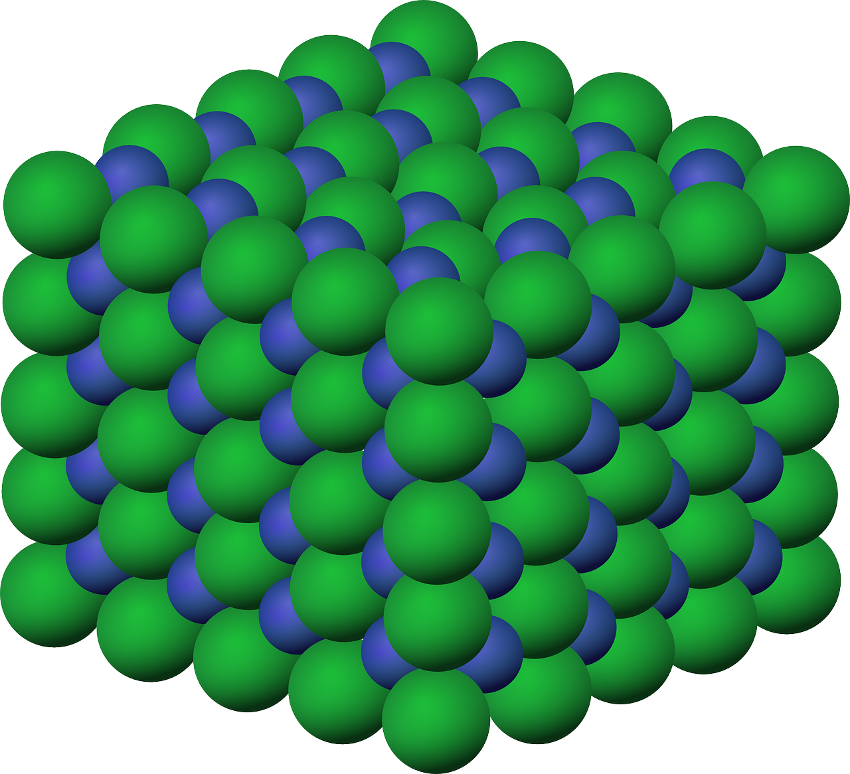
P4.1.4
03/02/2025
Gas Pressure
P4.1.1 Prior Knowledge Review
P4.1.2 Density
P4.1.3 Measuring Density
P4.1.4 Gas Pressure
P4.1.5 Taking it Further: Pressure
P4.1.6 Taking it Further: Pressure in Fluids
Notes:
Big Idea: Energy is Conserved.
This lesson contains a combination of combined science and physics only content, which is signposted. This builds on students’ understanding of the movement of particles and the relationship between energy and force.
Suggested Hook:
The most engaging way to start this lesson is with a demo of the collapsing can (or video, if this is not possible).
See instructions:
http://www.scifun.org/homeexpts/COLLAPSE.html
https://www.youtube.com/watch?v=J0VwYWDyGL0

Slide 6

Following this lesson, students will be able to:
Explain what is meant by gas pressure
Describe the relationship between temperature and pressure in a gas
Explain the relationship between temperature and pressure in a gas
Key Words:
gas
pressure
force
collision
area
temperature
Notes:
Guidance:
See unit overview document and planning guidance to see how these objectives are typically assessed at GCSE, including examples of what students should be able to do following this lesson.
Planning for different needs:
The learning objectives given on this slide are suggested based on the most common requirements for exams, however they can be adapted based on the needs of different classes.
For best practice, the unit preparation booklet should be used to determine the appropriate focus of lessons within the unit.
While it is not possible to explicitly split content into levelled grades, we recommend that lesson objectives can be classified as critical, core or stretch.
Critical: the content or skill is essential for all students to be able to progress.
Core: the content or skill is important for students to progress, but other opportunities may be available to revisit it.
Stretch: the content or skill may not be essential for all students but is important for students aiming for the highest grades.
Key skill: this is a crucial skill being developed in this unit as part of the skill mapping
P4.1.4 Lesson Objectives:
Core: Explain what is meant by gas pressure
Critical: Describe the relationship between temperature and pressure in a gas
Critical: Explain the relationship between temperature and pressure in a gas

Slide 7
Following this lesson, students will be able to:
Describe and explain the relationship between temperature and pressure in a gas
Describe and explain the relationship between volume and pressure of a gas
Apply the equation p₁V₁ = p₂V₂
Key Words:
gas
pressure
force
volume
collision
area
temperature
Notes:
Objectives for Physics only
Guidance:
See unit overview document and planning guidance to see how these objectives are typically assessed at GCSE, including examples of what students should be able to do following this lesson.
Planning for different needs:
The learning objectives given on this slide are suggested based on the most common requirements for exams, however they can be adapted based on the needs of different classes.
For best practice, the unit preparation booklet should be used to determine the appropriate focus of lessons within the unit.
While it is not possible to explicitly split content into levelled grades, we recommend that lesson objectives can be classified as critical, core or stretch.
Critical: the content or skill is essential for all students to be able to progress.
Core: the content or skill is important for students to progress, but other opportunities may be available to revisit it.
Stretch: the content or skill may not be essential for all students but is important for students aiming for the highest grades.
Key skill: this is a crucial skill being developed in this unit as part of the skill mapping
P4.1.4 Lesson Objectives:
Critical: Describe and explain the relationship between temperature and pressure in a gas
Critical: Describe and explain the relationship between volume and pressure of a gas
Critical: Apply the equation p₁V₁ = p₂V₂

Slide 8
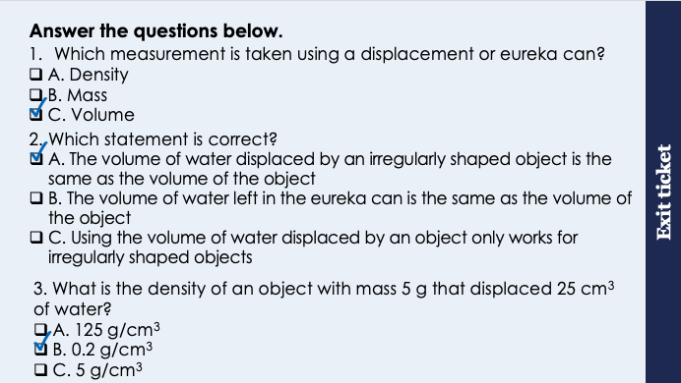
This is the fix-it portion of the lesson
The fix-it is an opportunity to respond to gaps in knowledge, especially those identified by the previous lesson’s exit ticket.
The teacher should customise this slide as needed, to facilitate
reteach, explanation, demonstration or modelling of ideas and concepts that students have not yet grasped or have misunderstood.
practise answering specific questions or of key skills.
redrafting or improving previous work.
Notes:
Purpose: to spend time on any gaps identified in previous learning from exit ticket feedback.
Fix-it guidance from previous exit ticket:
Q1. Answer: C
If students answer A or B, they are not clear on the function of a displacement or eureka can. To fix-it, review the purpose of a balance and the displacement can in the method to determine density.
Q2. Answer: A
If students answer B, they have confused the idea of the displaced liquid. To fix-it, review the process of using the displacement can. If students answer C, they have assumed that this method only works for irregularly shaped solids. To fix-it, explain to students that this method could also be used for regularly shaped solids, but it is simpler to use mathematical formulae.
Q3. Answer: B
If students answer A, they have multiplied mass by volume. If students answer C, they have divided volume by mass. To fix-it, give students further practice questions, mixing between calculating mass, volume and density.

Slide 9
Label the graph
Use labels to explain what is happening at each stage A-E. You should include information on:
Temperature
Internal energy
Kinetic energy
Potential energy
State (solid, liquid, or gas)
Name of the process
E
D
Temperature (ºC)
C
B
A
Energy (J)
Stretch: how does this graph show that the specific latent heat of vaporisation is greater than the specific latent heat of fusion?
Notes:
You may want to use this heating curve as a reminder for students what happens to the internal energy (and potential or kinetic energy) when a substance is heated.
Questions you could ask the students:
What two things might happen to water if you heat it?
How would you measure the temperature of ice?
What happens to the temperature of ice when it melts?

Slide 10
LIQUID.
Temperature increasing. Internal energy increasing.
Kinetic energy increasing.
Potential energy remains constant.
GAS.
Temperature increasing. Internal energy increasing.
Kinetic energy increasing.
Potential energy remains constant.
Label the graph
MELTING.
Temperature remains constant. Internal energy increasing.
Kinetic energy remains constant.
Potential energy increasing.
Temperature (ºC)
BOILING.
Temperature remains constant. Internal energy increasing.
Kinetic energy remains constant.
Potential energy increasing.
SOLID.
Temperature increasing. Internal energy increasing.
Kinetic energy increasing.
Potential energy remains constant.
Energy (J)
Notes:
Stretch: how does this graph show that the specific latent heat of vaporisation is greater than the specific latent heat of fusion?
Answer: the line is longer. This means that more energy is supplied during the change of state from liquid to gas than from solid to liquid. This is because more energy is needed to overcome all the forces of attraction holding the molecules together.
Note - this would still be the case if time was on the x axis, assuming that the substance was heated at a constant rate (i.e. the rate of energy transfer/the power stays constant) so using E = P x t, more energy is transferred during a longer period of time.

Slide 11

Gas Pressure
Particles is a gas move at random speeds in random directions.
They collide with each other and with the walls of their container.
When they collide with the walls of the container, they exert a force on it. This is gas pressure.
Pressure is a measure of the force exerted per unit area.
Notes:
Suggested exposition:
The particles in a gas are moving very quickly in random directions.
Get students to try and follow the path of a particle in the gif.
The particles are actually all moving at different speeds, but the average speed of particles is much faster than the movement of particles in a solid or liquid. Because these particles are moving quickly and randomly in all directions, there are frequent collisions, between particles and between particles and the walls of the container. When the particles hit the walls of the container, they exert a force on it.
If you think about blowing up a balloon, we blow air into the balloon. Once the particles are inside the balloon, they start to collide with the walls of the balloon. This is what gives the balloon its shape.
This force when the particles hit the walls is exerted at right angles to the walls of the container. From KS3, we know that pressure is the force exerted per unit area, and it is the same idea here. The more force exerted by a particle on the wall of the container, the more pressure is being exerted.
What is the unit of force?
Newtons
What are the units of area?
cm² or m²
What are the units of pressure?
N/cm² or N/m2. 1 N/m² = 1 Pascal, which is another unit we can use.
The pressure exerted by gas particles can change depending on how quickly the particles are moving and how often they collide with the walls of the container.
Gif source:
https://commons.wikimedia.org/wiki/Category:Brownian_motion#/media/File:Brownianmotion5particles150frame.gif

Slide 12
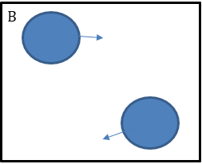
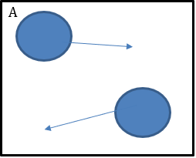
Gas Pressure and Temperature
A
B
When a substance is heated, its internal energy increases.
Temperature is a measure of the average kinetic energy of all the particles in a system.
When temperature is increased, gas particles gain kinetic energy and move more quickly.
The gas particles are moving more quickly so collide more often with the walls of the container and with more force.
This means they exert more pressure.
Pressure
Temperature
Notes:
Suggested exposition:
So the pressure exerted by gas particles can change depending on how quickly the particles are moving and how often they collide with the walls of the container. How can the speed of particles or the frequency of collisions be changed?
When a substance is heated, its internal energy increases. When this substance is a gas, the kinetic energy of the particles increases.
The temperature of a substance is a measure of the average kinetic energy of its particles, so the higher the temperature, the greater the average kinetic energy of the particles, and the faster they are moving.
If we keep the volume of a container the same but increase its temperature, the pressure exerted by the gas increases. We have to keep the volume constant, because otherwise this will also affect the pressure.
So when the temperature of a gas at constant volume is increased, the pressure of the gas increases. This is because the particles are travelling faster, so they will collide with the walls of the container with more force and more frequently.
Animate graph.
What does this graph show about the relationship between temperature and pressure of a gas?
As temperature increases, gas pressure increases.
Is this directly proportional?
No. They are propotional, but not directly proportional because as one doubles, the other does not also double.

Slide 13
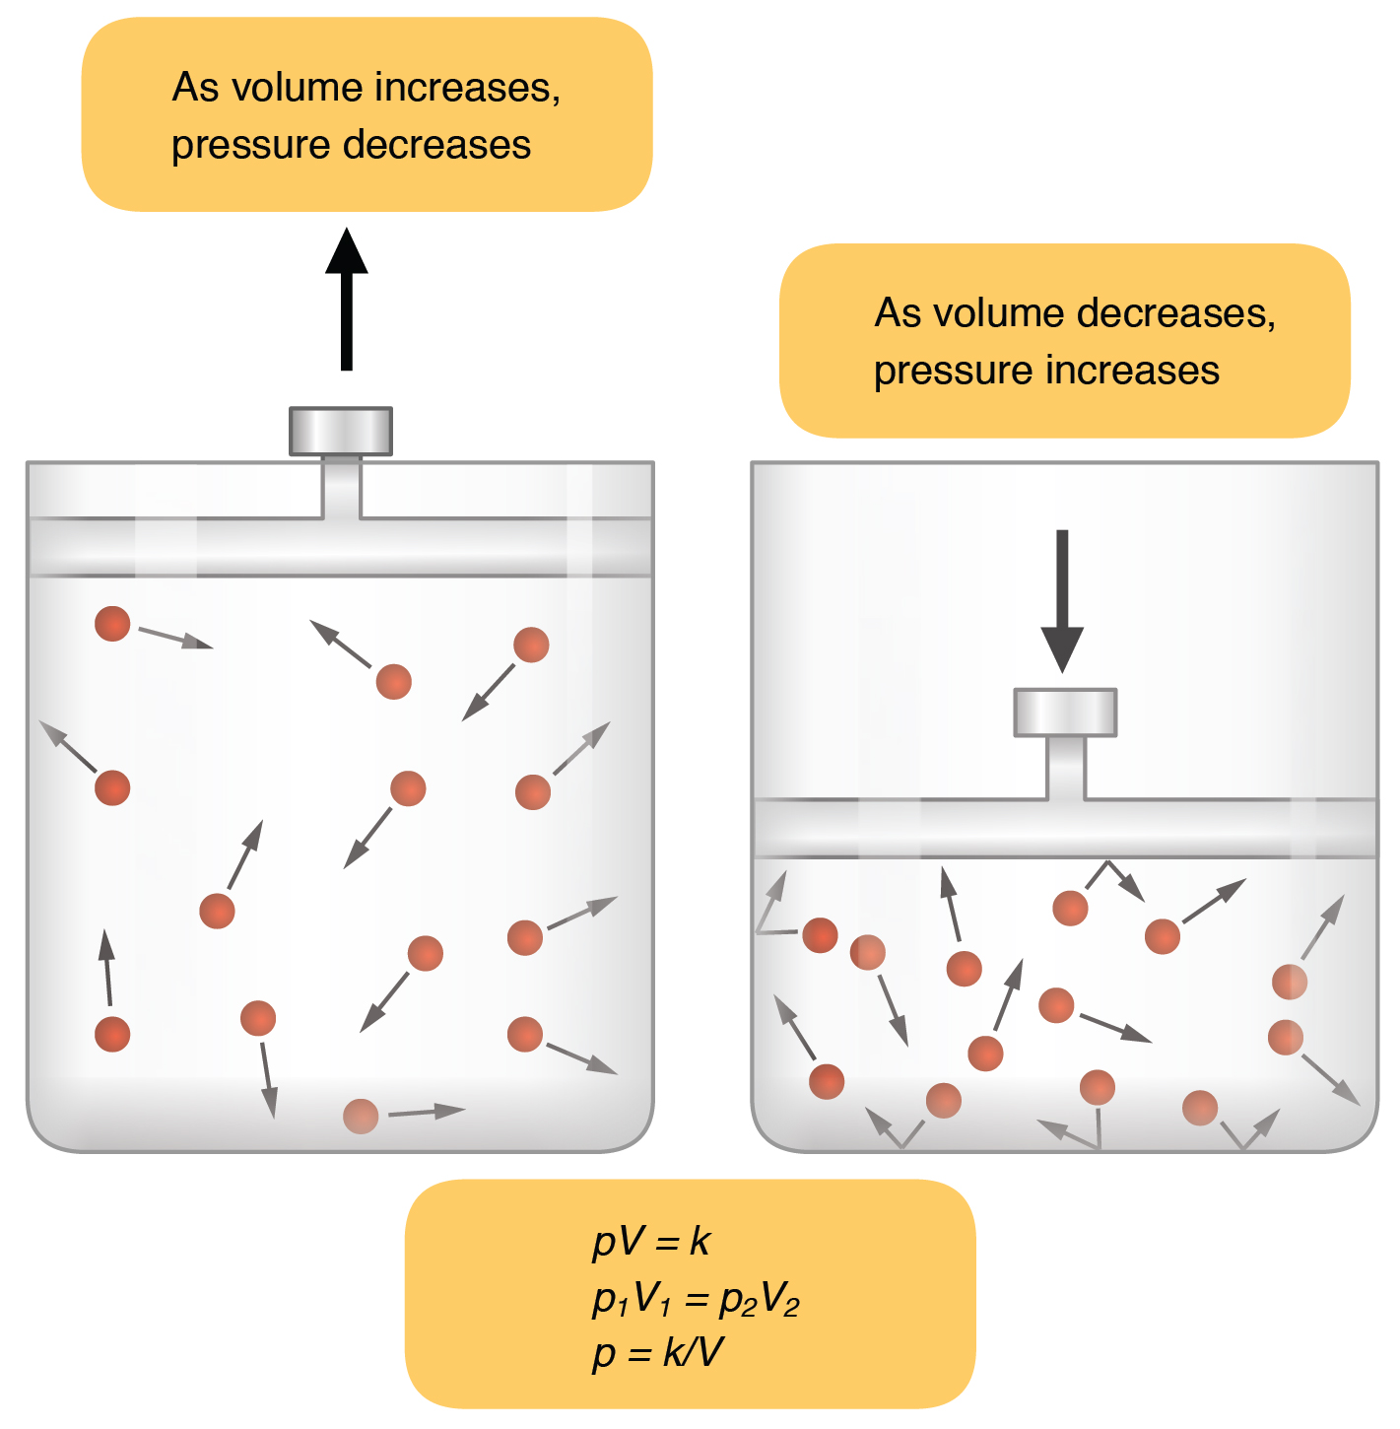
Pressure and Volume
When the volume of a container is decreased, the pressure exerted by the gas increases.
Particles have less space to move around, so collide with the walls of the container more frequently.
The temperature of the gas and the mass of the gas must remain constant.
Notes:
Physics only
Suggested exposition:
So we can change the pressure of a gas by changing its temperature. If we keep the temperature constant, but change the volume of the container, we can also change the pressure exerted by the gas.
If you squeeze a balloon to make it smaller and keep squeezing it, eventually it will pop. Why?
Squeezing it decreases the volume of the container, which increases the pressure inside it until eventually the pressure is too great and causes the balloon to burst.
So decreasing the volume of the container increases the pressure. Why?
If the temperature of a gas stays the same (because otherwise this would affect the pressure and confound the results), the pressure of the gas increases as the volume of its container decreases. This is because the same number of particles collide with the walls of the container more often as there is less space for them to move around in. As the temperature is constant, the particles still collide with the same amount of force, but there are more collisions, so the overall force exerted is greater.
This is a relationship that was investigated by Robert Boyle, who gave his name to the Law and corresponding equation used. Boyle was able to show that volume is inversely proportional to pressure. For this law to apply, there has to be a constant temperature and a constant mass of gas, as this means that there are the same number of particles in the gas.
Image source:
CC@https://commons.wikimedia.org/wiki/File:2314_Boyles_Law.jpg

Slide 14

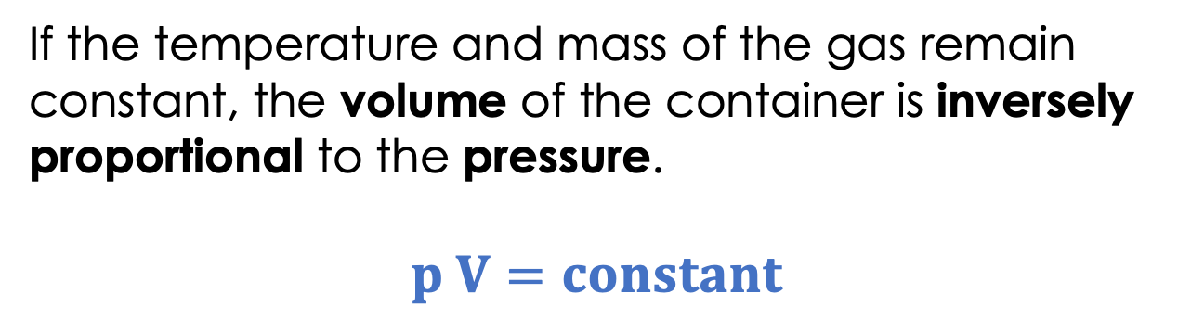




Pressure and Volume
This is an equation you will need to apply.
If the temperature and mass of the gas remain constant, the volume of the container is inversely proportional to the pressure.
$$p V=constant$$
We can use this equation to calculate the pressure or volume of a gas in a new scenario:
$$p1 V1=p2 V2$$
$$p1 V1=p2 V2$$
$$120 × 0.45=p2 × 0.6$$
Example:
A gas has a volume of 0.45 m³ at 120 Pa of pressure.
Calculate the pressure exerted by the gas if its container is expanded to 0.6 m³.
$$0.6 p2=54$$
$$p2=90 Pa$$
Notes:
Suggested exposition:
The equation that links pressure and volume is:
pressure × volume = constant
p V=constant
Where, pressure is measured in Pa and volume is measured in m³.
As pressure x volume = a constant, we can use this to determine the pressure or volume in a new scenario, if one of the quantities changes.
The change in volume or pressure for gas at a constant temperature can be calculated using the equation:
p1V1=p2V2
p₁ and V₁ are the pressure and volume before either are changed, p₂ and V₂ are the pressure and volume after the change.
Example
A gas occupies a volume of 0.50 m³ at a pressure of 100 Pa. Calculate the pressure exerted by the gas if it is compressed to a volume of 0.25 m³. Assume that the temperature and mass of the gas stay the same.
Rearrange p₁ V₁ = p₂ V₂ to find p₂:
p2=p1×v1V2
p2=100×0.500.25
New pressure: p2=200 Pa
QuestionIf a gas has a pressure of 200,000 Pa when it is in a volume of 10 m³, what will its pressure be if the volume is reduced to 2.5 m³?

Slide 15
You: The relationship between volume and pressure
The table shows how the pressure exerted by a gas changes when the volume of its container changes.
Volume (cm³) | Pressure (kPa)
30 | 200
48 | 125
60 | 100
96 | 62.5
Describe the relationship shown in the table.
The pressure of a gas is inversely proportional to its volume.
Use values from the table to show this relationship.
As volume doubles (from 30 to 60 cm³, or from 48 to 96 cm³), the pressure halves (from 200 to 100 kPa, or from 125 to 62.5 kPa.
According to the equation pV = constant. Calculate the constant of this gas.
pV = constant
30 x 200 = 6000
pV = constant
p x 100 = 6000
p = 60 kPa
Use this information to predict the pressure of the gas when its volume is 100 cm³.

Slide 16
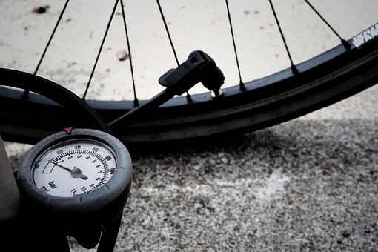
Changing Pressure
Higher Tier only
Work is the transfer of energy by a force.
When a force is applied to a gas, work is done on the gas.
This increases the internal energy of the gas and can cause an increase in its temperature.
Notes:
Suggested exposition:
When a gas is compressed, the volume is decreased. Compressing a gas requires a force and energy is transferred by the action of this force so we can say that work is done on the gas. This energy is transferred to the internal energy of the gas, so the kinetic energy store of the particles has increased. We know this is not filling the potential energy store as there is not a change in state.
Temperature is related to the average kinetic energy of the particles, so if the average kinetic energy of the gas particles increases, the temperature of the gas increases. Therefore compressing a gas causes an increase in its temperature.
Demo: Plastic syringes – compress gas with finger over end, try to increase volume with finger over the end. Have two sealed syringes: one filled with water, the other with air. Show you can compress the air one, but not the one filled with water.
Potential demo of heat production in a bicycle inner tube as it is pumped up.
Emphasise that the pressure produces a net force at right angles to the wall of the gas container (or any surface). The IoP has an adaptation of the pressure in a water column experiment to support with this idea: https://spark.iop.org/investigating-pressure-water-column.
Marvin and Milo – Cup trick https://spark.iop.org/cup-trick
BEST evidence science teaching has a diagnostic ‘Inflation’ which may be worth using at this stage.
Notes: The work done pushing the piston transforms into an increase in the internal energy (and thus an increase in the temperature) of the air molecules within the pump. People familiar with hand bicycle pumps will attest to the fact that they get hot after use. Likewise, when a gas is allowed to expanded into a region of reduced pressure it does work on its surroundings. The energy to do this work comes from the internal energy of the gas and so the temperature of the gas drops. You can experience this yourself without the aid of any apparatus other than your mouth. Purse your lips so that your mouth has only a tiny opening to the outside and blow hard. The air rushing from your mouth will be quite cool despite coming from the core of your body, which is normally quite hot (around 37 °C). During a "fast" process like the ones just described, pressure and volume are changing so rapidly that heat doesn't have enough time to get into or out of the gas to keep the temperature constant. https://physics.info/gas-laws/
Potential practical: Shaking soda: https://streaming.discoveryeducation.com/teacherCenter/lessonPlans/pdfs/6-8_Science_SodaAndCelsiusAnExperimentWithHeatAndTemperatureUsingCarbonation.pdf
This video explains this phenomenon succinctly: https://www.youtube.com/watch?v=m19-8Vtewkw

Slide 17




Which statements do you agree with?
A gas at a higher temperature exerts more pressure than the same gas at a lower temperature
When a substance is cooled, the particles gain energy
Gas pressure is caused by the particles of a gas colliding with each other
Pressure can be measured in Pascals
Notes:
Suggested points:
Blue: incorrect. When a substance is cooled, the particles lose energy. This is included so that students don’t just learn the sentence ‘particles gain energy’ and apply it to any scenario.
Yellow: correct.
Green: incorrect. Gas pressure is caused by the particles of gas colliding with the walls of the container/surfaces.
Pink: correct.
Suggested guidance:
Talk tasks can be used in a variety of ways to suit the particular needs of the students you are teaching. Through exchanging views with others, students develop their understanding of the science beyond what could be achieved individually.
Science classrooms that successfully integrate talk have the following features:
Science talk is a regular feature of lessons and is woven into classroom activities.
Students are paired or grouped strategically by the teacher to ensure productive interaction. This might take into consideration the students’ proficiency of the English language, how encouraging they might be to peers and their attainment in the topic. It’s a good idea to consider these pairings in the class seating plan.
Students are encouraged and supported to talk, but are not forced to talk.
The teacher should take on the role of a facilitator, engaging with conversations where necessary and encouraging or steering the conversation where needed.
Students are encouraged to use the language they have to express their ideas (e.g., everyday language, imperfect English, native language), but also to incorporate science specific terminology where this is more accurate or has been taught.
6. Scientifically inaccurate ideas are not dismissed by the partner or teacher; open discussion and further investigation are relied on to help students construct ideas that support them to progress in their scientific understanding.
7. Guidelines for behaviour during talk tasks are explicit and frequently reviewed. Rules for students might be:
Listen carefully to your partner
Take turns talking.
Speak one at a time, without interrupting.
Politely agree or disagree and explain why.
Politely point out if your partner has used a scientific word incorrectly, if they have explained the science incorrectly, or if there is a more accurate way to describe something.
If confused, ask questions.
Stay focused on the discussion topic.
Respond to one another.

Slide 18

Can you describe and explain the difference between these two particle diagrams?
These two particle diagrams show the same gas.
How would the movement of particles be different?
How would the pressure exerted be different?
Why?
20 ºC
40 ºC
Notes:
Suggested points:
The particles in the gas at a higher temperature have more kinetic energy so move more quickly.
They would exert more pressure on the walls of the container because they are moving more quickly, so this means they collide with the walls more frequently and with more force.
Suggested guidance:
Talk tasks can be used in a variety of ways to suit the particular needs of the students you are teaching. Through exchanging views with others, students develop their understanding of the science beyond what could be achieved individually.
Science classrooms that successfully integrate talk have the following features:
Science talk is a regular feature of lessons and is woven into classroom activities.
Students are paired or grouped strategically by the teacher to ensure productive interaction. This might take into consideration the students’ proficiency of the English language, how encouraging they might be to peers and their attainment in the topic. It’s a good idea to consider these pairings in the class seating plan.
Students are encouraged and supported to talk, but are not forced to talk.
The teacher should take on the role of a facilitator, engaging with conversations where necessary and encouraging or steering the conversation where needed.
Students are encouraged to use the language they have to express their ideas (e.g., everyday language, imperfect English, native language), but also to incorporate science specific terminology where this is more accurate or has been taught.
6. Scientifically inaccurate ideas are not dismissed by the partner or teacher; open discussion and further investigation are relied on to help students construct ideas that support them to progress in their scientific understanding.
7. Guidelines for behaviour during talk tasks are explicit and frequently reviewed. Rules for students might be:
Listen carefully to your partner
Take turns talking.
Speak one at a time, without interrupting.
Politely agree or disagree and explain why.
Politely point out if your partner has used a scientific word incorrectly, if they have explained the science incorrectly, or if there is a more accurate way to describe something.
If confused, ask questions.
Stay focused on the discussion topic.
Respond to one another.

Slide 19
Drill
Describe the movement of particles in a gas.
Describe the properties of gases.
Describe what happens to the internal energy of a gas when it is heated.
Describe what happens to the movement of particles when a substance is cooled.
Describe the relationship between temperature and pressure.
Explain the relationship between temperature and pressure.
Physics
Describe the relationship between pressure and volume.
State the two factors that must stay the same for this relationship to apply.
Notes:
Purpose: This is a knowledge drill. The purpose of this is to check that the critical knowledge is secure before pupils move onto independent practice.
Suggested guidance: There are a range of ways this could be done depending on time and ability range of the class:
Mini whiteboards
As full sentences in exercise books
As short answers in exercise books
In the pupil workbook
As pair talk
As cold call

Slide 20
Drill answers
Particles move at random speeds in random directions
Gases can flow, take the shape of their container, do not have a fixed shape or volume and can be compressed
Internal energy increases
Particles lose kinetic energy so move less quickly
As temperature increases, pressure increases
Particles at higher temperatures have more kinetic energy so move more quickly, colliding with the surface of the container harder and more frequently, exerting more pressure
Physics
Pressure and volume are inversely proportional
The number of particles (mass) and the temperature of the gas
Notes:
Purpose: This is a knowledge drill. The purpose of this is to check that the critical knowledge is secure before pupils move onto independent practice.
Suggested guidance: There are a range of ways this could be done depending on time and ability range of the class:
Mini whiteboards
As full sentences in exercise books
As short answers in exercise books
In the pupil workbook
As pair talk
As cold call

Slide 21

I: Explain: to use scientific understanding to make something clear or state the reason for something happening
Example question:
To ‘explain’ your answer should:
Begin with a scientific statement.
Use ‘this means that’, ‘because’ or ‘so’ to link your statement to the question.
Explain what happens to the pressure of a gas as temperature increases.
Model answer:
Increasing the temperature increases the kinetic energy of the particles in a gas
This means the particles start to move more quickly and hit the surface of the container more often and with more force
So, this increases the pressure exerted by the gas
Notes:
This slide models the process of answering an explain question.
Firstly, students are presented with a generic explain question, along with a model answer. Students are also given some simple guidance to follow for producing their own describe answer.
The generic question and answer should be used by the teacher to remind students of
the key features of a great answer
how to structure their answer
why the model answer is a good example
Following this, students will be required to apply this process to answer their own explain question, which will appear in place of the generic questions. This explain question will be specific to the topic students are learning about in the lesson. Give students time to write their own answer to this, ensuring that they use the guidance provided. To further scaffold this task for students, it may be appropriate to:
pair students up to write an answer together
list for students the key words you would like them to include in the answer
provide a writing frame or ‘points to include’ for students
A model answer for this question will appear. Teachers should review the model answer with students by referencing the guidance in the green box. For example ‘we can see item 1 in the guidance is to begin with a scientific statement. Notice in the model answer here we have done just that’. Or ‘item 2 in the guidance here says that we should use a linking statement in the answer. Has this been achieved in the model answer? Where can we see this?’.

Slide 22
We: Explain: to use scientific understanding to make something clear or state the reason for something happening
Example question:
To ‘explain’ your answer should:
Begin with a scientific statement.
Use ‘this means that’, ‘because’ or ‘so’ to link your statement to the question.
Explain what happens to the pressure of a gas as temperature decreases.
Model answer:
Decreasing the temperature decreases the kinetic energy of the particles in a gas
This means the particles start to move less quickly and hit the surface of the container less often and with less force
So, this decreases the pressure exerted by the gas
Notes:
This slide models the process of answering an explain question.
Firstly, students are presented with a generic explain question, along with a model answer. Students are also given some simple guidance to follow for producing their own describe answer.
The generic question and answer should be used by the teacher to remind students of
the key features of a great answer
how to structure their answer
why the model answer is a good example
Following this, students will be required to apply this process to answer their own explain question, which will appear in place of the generic questions. This explain question will be specific to the topic students are learning about in the lesson. Give students time to write their own answer to this, ensuring that they use the guidance provided. To further scaffold this task for students, it may be appropriate to:
pair students up to write an answer together
list for students the key words you would like them to include in the answer
provide a writing frame or ‘points to include’ for students
A model answer for this question will appear. Teachers should review the model answer with students by referencing the guidance in the green box. For example ‘we can see item 1 in the guidance is to begin with a scientific statement. Notice in the model answer here we have done just that’. Or ‘item 2 in the guidance here says that we should use a linking statement in the answer. Has this been achieved in the model answer? Where can we see this?’.

Slide 23
You: Explain: to use scientific understanding to make something clear or state the reason for something happening
Example question:
To ‘explain’ your answer should:
Begin with a scientific statement.
Use ‘this means that’, ‘because’ or ‘so’ to link your statement to the question.
Explain the relationship between temperature and pressure of a gas.
Model answer:
Increasing the temperature increases the kinetic energy of the particles in a gas
This means the particles start to move more quickly and hit the surface of the container more often and with more force
So, this increasing temperature increases the pressure exerted by the gas
Notes:
This slide models the process of answering an explain question.
Firstly, students are presented with a generic explain question, along with a model answer. Students are also given some simple guidance to follow for producing their own describe answer.
The generic question and answer should be used by the teacher to remind students of
the key features of a great answer
how to structure their answer
why the model answer is a good example
Following this, students will be required to apply this process to answer their own explain question, which will appear in place of the generic questions. This explain question will be specific to the topic students are learning about in the lesson. Give students time to write their own answer to this, ensuring that they use the guidance provided. To further scaffold this task for students, it may be appropriate to:
pair students up to write an answer together
list for students the key words you would like them to include in the answer
provide a writing frame or ‘points to include’ for students
A model answer for this question will appear. Teachers should review the model answer with students by referencing the guidance in the green box. For example ‘we can see item 1 in the guidance is to begin with a scientific statement. Notice in the model answer here we have done just that’. Or ‘item 2 in the guidance here says that we should use a linking statement in the answer. Has this been achieved in the model answer? Where can we see this?’.

Slide 24
I: Explain: to use scientific understanding to make something clear or state the reason for something happening
Example question:
To ‘explain’ your answer should:
Begin with a scientific statement.
Use ‘this means that’, ‘because’ or ‘so’ to link your statement to the question.
Explain what happens to the pressure of a gas as its volume decreases.
Model answer:
Decreasing the volume of a gas reduces the amount of space the particles have to move around in
This means the particles will collide with the surface of the container more often
So, this increases the pressure exerted by the gas
Notes:
This slide models the process of answering an explain question.
Firstly, students are presented with a generic explain question, along with a model answer. Students are also given some simple guidance to follow for producing their own describe answer.
The generic question and answer should be used by the teacher to remind students of
the key features of a great answer
how to structure their answer
why the model answer is a good example
Following this, students will be required to apply this process to answer their own explain question, which will appear in place of the generic questions. This explain question will be specific to the topic students are learning about in the lesson. Give students time to write their own answer to this, ensuring that they use the guidance provided. To further scaffold this task for students, it may be appropriate to:
pair students up to write an answer together
list for students the key words you would like them to include in the answer
provide a writing frame or ‘points to include’ for students
A model answer for this question will appear. Teachers should review the model answer with students by referencing the guidance in the green box. For example ‘we can see item 1 in the guidance is to begin with a scientific statement. Notice in the model answer here we have done just that’. Or ‘item 2 in the guidance here says that we should use a linking statement in the answer. Has this been achieved in the model answer? Where can we see this?’.

Slide 25
We: Explain: to use scientific understanding to make something clear or state the reason for something happening
Example question:
To ‘explain’ your answer should:
Begin with a scientific statement.
Use ‘this means that’, ‘because’ or ‘so’ to link your statement to the question.
Explain what happens to the pressure of a gas as its volume increases.
Model answer:
Increasing the volume of a gas increases the amount of space the particles have to move around in
This means the particles will collide with the surface of the container less often
So, this decreases the pressure exerted by the gas
Notes:
This slide models the process of answering an explain question.
Firstly, students are presented with a generic explain question, along with a model answer. Students are also given some simple guidance to follow for producing their own describe answer.
The generic question and answer should be used by the teacher to remind students of
the key features of a great answer
how to structure their answer
why the model answer is a good example
Following this, students will be required to apply this process to answer their own explain question, which will appear in place of the generic questions. This explain question will be specific to the topic students are learning about in the lesson. Give students time to write their own answer to this, ensuring that they use the guidance provided. To further scaffold this task for students, it may be appropriate to:
pair students up to write an answer together
list for students the key words you would like them to include in the answer
provide a writing frame or ‘points to include’ for students
A model answer for this question will appear. Teachers should review the model answer with students by referencing the guidance in the green box. For example ‘we can see item 1 in the guidance is to begin with a scientific statement. Notice in the model answer here we have done just that’. Or ‘item 2 in the guidance here says that we should use a linking statement in the answer. Has this been achieved in the model answer? Where can we see this?’.

Slide 26
You: Explain: to use scientific understanding to make something clear or state the reason for something happening
Example question:
To ‘explain’ your answer should:
Begin with a scientific statement.
Use ‘this means that’, ‘because’ or ‘so’ to link your statement to the question.
Explain the relationship between volume and pressure of a gas.
Model answer:
Decreasing the volume of a gas reduces the amount of space the particles have to move around in
This means the particles will collide with the surface of the container more often
So, decreasing the volume increases the pressure exerted by the gas
They are inversely proportional
Notes:
This slide models the process of answering an explain question.
Firstly, students are presented with a generic explain question, along with a model answer. Students are also given some simple guidance to follow for producing their own describe answer.
The generic question and answer should be used by the teacher to remind students of
the key features of a great answer
how to structure their answer
why the model answer is a good example
Following this, students will be required to apply this process to answer their own explain question, which will appear in place of the generic questions. This explain question will be specific to the topic students are learning about in the lesson. Give students time to write their own answer to this, ensuring that they use the guidance provided. To further scaffold this task for students, it may be appropriate to:
pair students up to write an answer together
list for students the key words you would like them to include in the answer
provide a writing frame or ‘points to include’ for students
A model answer for this question will appear. Teachers should review the model answer with students by referencing the guidance in the green box. For example ‘we can see item 1 in the guidance is to begin with a scientific statement. Notice in the model answer here we have done just that’. Or ‘item 2 in the guidance here says that we should use a linking statement in the answer. Has this been achieved in the model answer? Where can we see this?’.

Slide 27
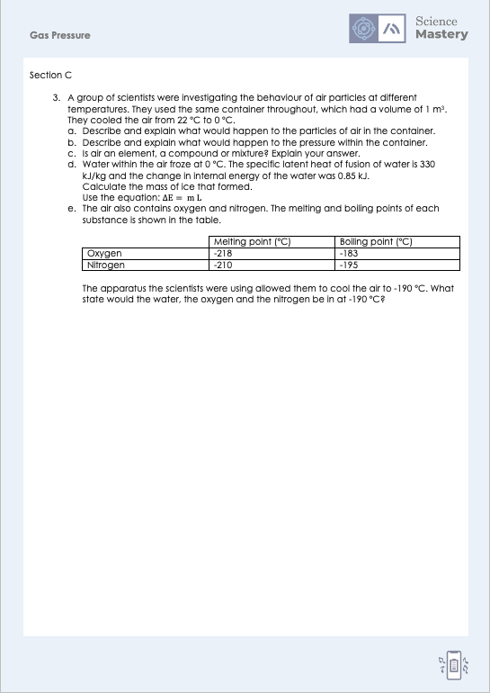
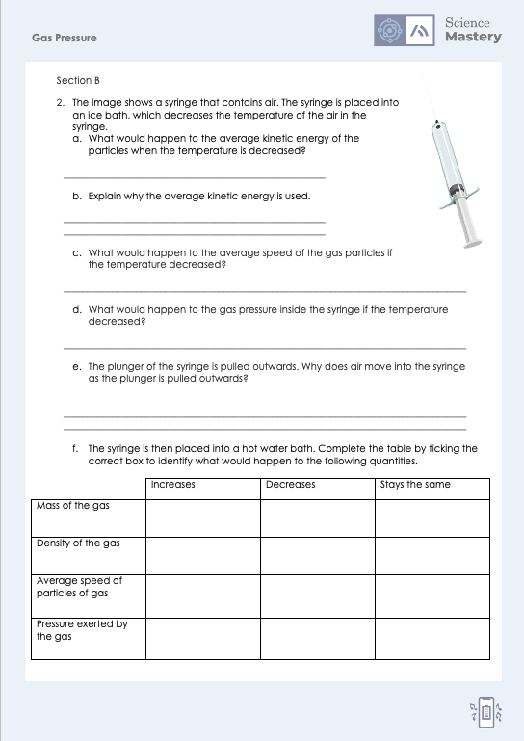
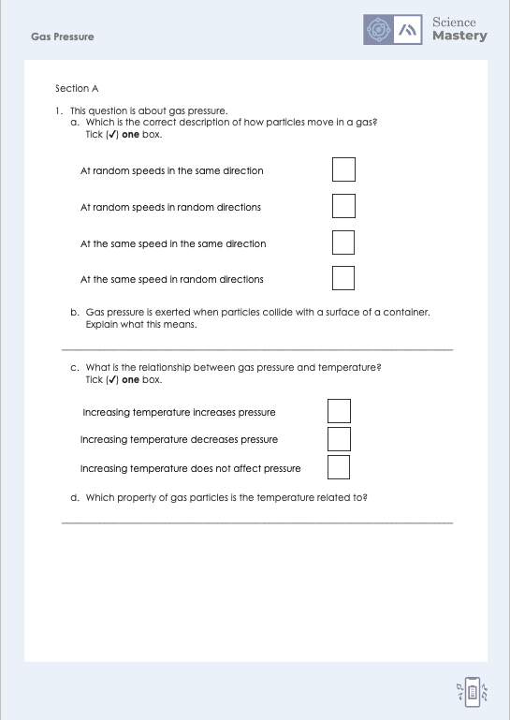
Activity (Combined Science)
Notes:
Note: there are two versions of this worksheet, the worksheet labelled physics only contains the additional separate science content.

Slide 28
Answers
1a. At random speeds in random directions
1b. Particles are moving so they exert a force on the surface when they collide with it.
1c. Increasing temperature increases pressure
1d. Average kinetic energy
2a. Average kinetic energy of particles would decrease
2b. Because particles don’t all have exactly the same amount of kinetic energy
2c. Average speed of particles would decrease
2d. Pressure would decrease

Slide 29
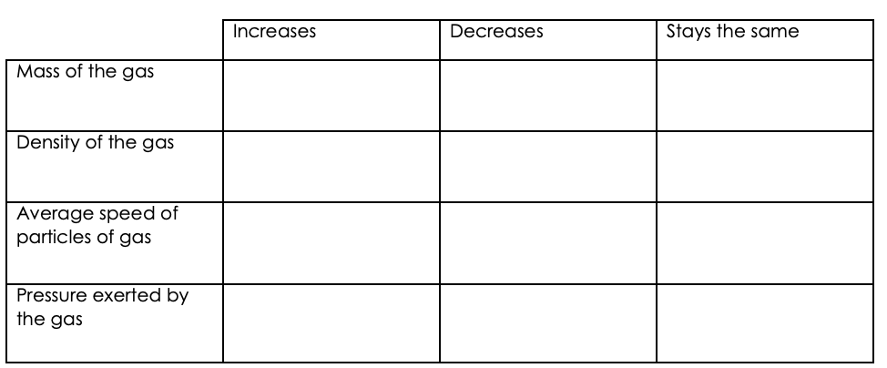
Answers
2e. Because pressure outside the syringe is greater than pressure inside the syringe
2f.
✓
✓
✓
✓

Slide 30
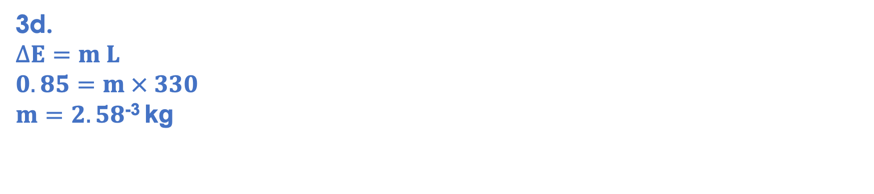
Answers
3a. The particles would lose kinetic energy, causing the average speed of particles to decrease.
3b. The pressure inside the container would decrease because the particles have a lower speed so they exert less force on the walls of the container when they collide with it (which also happens less often)
3c. Air is a mixture because it contains different elements and compounds, which are not all chemically combined together.
3d.
$$∆E=m L$$
$$0.85=m × 330$$
$m=2.58$⁻³ kg
3e. Water = solid, oxygen = liquid, nitrogen = gas

Slide 31
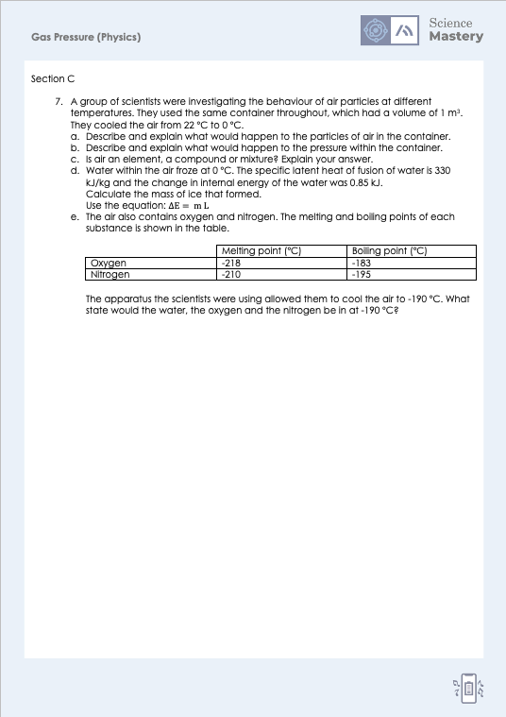
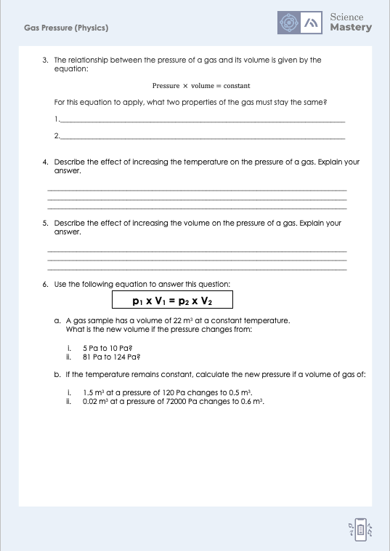
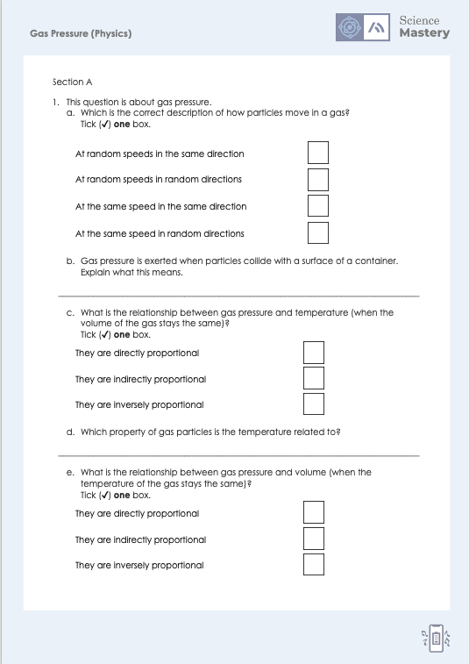
Activity (Physics)
Notes:
Note: there are two versions of this worksheet, the worksheet labelled physics only contains the additional separate science content.

Slide 32
Answers
1a. At random speeds in random directions
1b. Particles are moving so they exert a force on the surface when they collide with it.
1c. They are directly proportional
1d. Average kinetic energy
1e. They are inversely proportional
2a. Average kinetic energy of particles would decrease
2b. Because particles don’t all have exactly the same amount of kinetic energy
2c. Average speed of particles would decrease
2d. Pressure would decrease

Slide 33
Answers
2e. Because pressure outside the syringe is greater than pressure inside the syringe
2f.
✓
✓
✓
✓

Slide 34
Answers
3.
Mass of the gas
Temperature of the gas
4. Increasing the temperature increases the pressure of a gas. This is because particles gain kinetic energy, so they collide with the walls of the container more often and with more force, exerting more pressure.
5. Increasing the volume decreases the pressure of a gas. This is because particles have more space to move around, so they collide with the walls of the container less frequently, exerting less pressure.

Slide 35
Answers
6ai. p₁ x V₁ = p₂ x V₂
5 Pa x 22 m³ = 10 Pa x V₂
110 = 10 V₂
V₂ = 11 m³
6aii. p₁ x V₁ = p₂ x V₂
81 Pa x 22 m³ = 124 Pa x V₂
1782 = 124 V₂
V₂ = 14.37 m³
6bi. p₁ x V₁ = p₂ x V₂
120 Pa x 1.5 m³ = p₂ x 0.5 m³
180 = 0.5 p₂
p₂ = 360 Pa
6bii. p₁ x V₁ = p₂ x V₂
72000 Pa x 0.02 m³ = p₂ x 0.6 m³
1440 = 0.6 p₂
p₂ = 2400 Pa

Slide 36
Answers
3a. The particles would lose kinetic energy, causing the average speed of particles to decrease.
3b. The pressure inside the container would decrease because the particles have a lower speed so they exert less force on the walls of the container when they collide with it (which also happens less often)
3c. Air is a mixture because it contains different elements and compounds, which are not all chemically combined together.
3d.
$$∆E=m L$$
$$0.85=m × 330$$
$m=2.58$⁻³ kg
3e. Water = solid, oxygen = liquid, nitrogen = gas

Slide 37
Answer the questions below.
Which describes the movement of particles in a gas?
A. All particles move randomly at the same speed
B. All particles move at different speeds in a pattern
C. All particles move at random speeds in random directions
✓
2. What would happen to the pressure in a sealed pot if it was heated?
A. The pressure would increase
B. The pressure would decrease
C. The pressure would stay the same
✓
3. Which statement is correct?
A. When particles are heated they expand
B. When particles are heated their internal energy increases
C. When particles are heated they exert less pressure on the walls of a container
✓
Notes:
Q1. Answer: C
If students answer A, they have understood the random nature of movement of particles of a gas, but not understood that the particles all have different speeds, which is a key idea and why average speed of particles is referred to. If students answer B, they recognise the different speeds but not the random nature of movements. To fix-it, review the animation or the PhET simulation to look at the movement of particles in a gas.
Q2. Answer: A
If students answer B or C, they have not understood the relationship between temperature and pressure. To fix-it, use the PhET simulation to show what happens to particles when they are heated and how this causes an increase in pressure.
Q3. Answer: B
If students answer A, they have the misconception that heating causes particles themselves to expland. If students answer C, they have confused the relationship between temperature and pressure. To fix-it, review the relationship between temperature and pressure, walking through the stages of heating a substance in terms of: particles gain kinetic energy (which increases internal energy), so average speed of particles increases, so they collide more frequently and with more force with the surface of the container.

Slide 38
Lesson P4.1.4
What was good about this lesson? | What can we do to improve this lesson?
Send us your feedback by clicking this link. Thank you!

